Slide 1
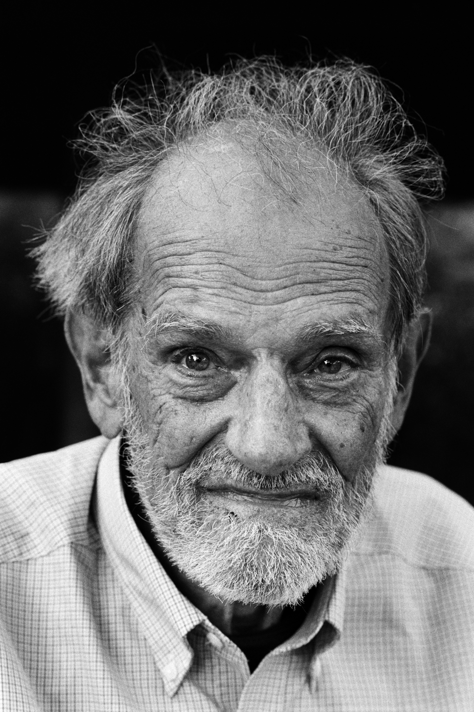
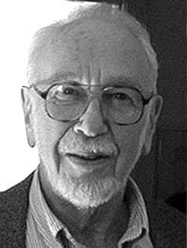
Solving Stable Matching Problems With the Gale-Shapley Algorithm
Christian Reyes
Enrique Treviño

Slide 2
Think About…

Slide 3
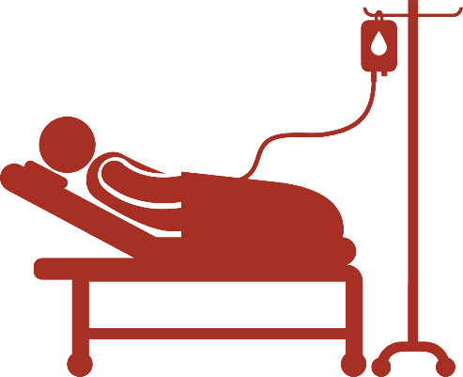
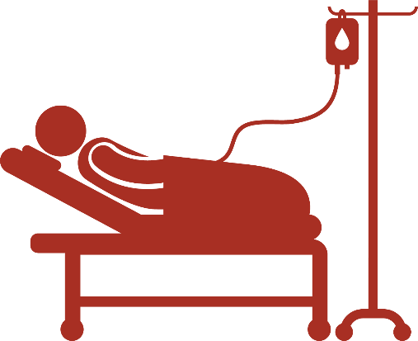
Imagine…

Slide 4
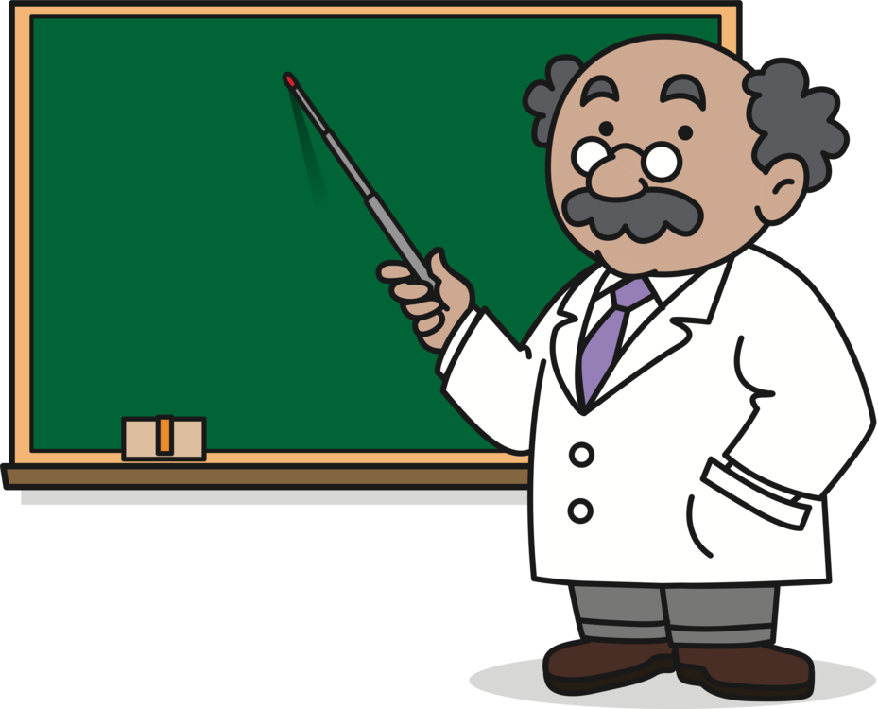
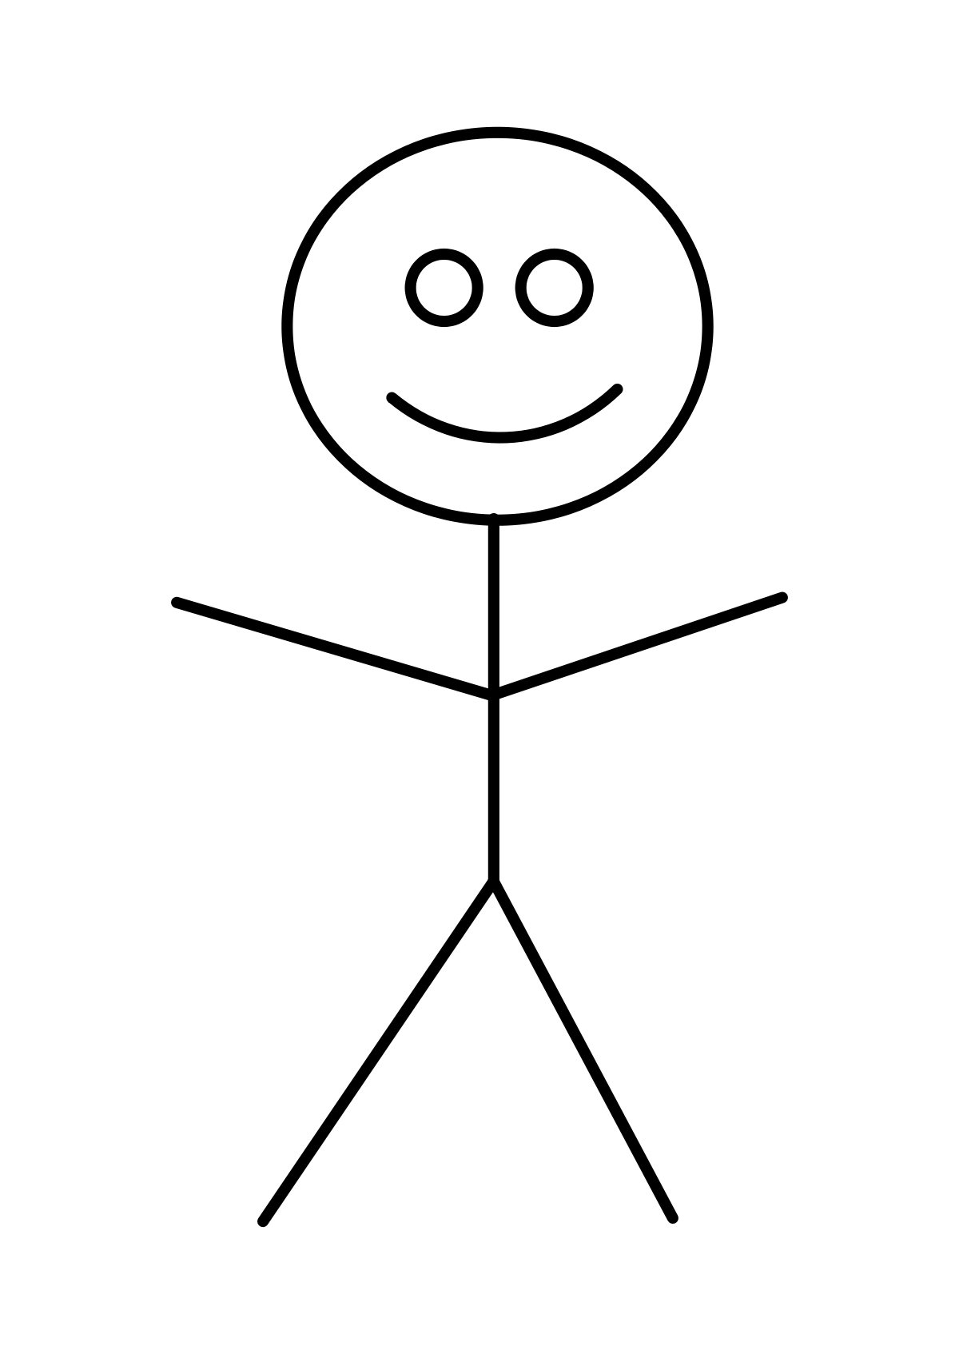
Finally…

Slide 5
Outline
Stable Matching and the Stable Marriage Problem
Richter Matching
What Next?

Slide 6
Stable Matching
Where there are no two members of the opposite group who would both rather have each other than their current match.
Unstable Match

Slide 7
The Stable Marriage Problem

Slide 8
Solving
1,2,3,4
3,2,1,4
1
2,3,4,1
4,3,2,1
2
2,4,1,3
2,1,3,4
3
4,2,3,1
3,2,4,1
4

Slide 9
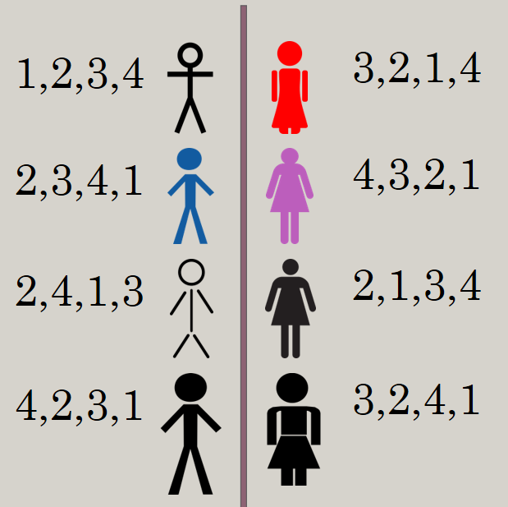
Solving (Cont.)
1
2
2
4
3

Slide 10
Solving (Cont.)
3
4
2
3
2
1

Slide 11
Man Optimal Matching
Woman Optimal Matching

Slide 12
Algorithm Overview
All men are made free
While there is still a man(m) not engaged
first woman(w) on m's list to whom he has not yet proposed
IF woman is free
Engaged (m, w)
ELSE
Test w's preference between m and m'
If m < m'
m is denied and must propose again
ELSE
(m, w) and m' becomes free.

Slide 13
Outline
Stable Matching and the Stable Marriage Problem
Richter Matching
What Next?

Slide 14
The Richter Matching

Slide 15
The Richter Matching (Cont.)
1
2
3
2, 3, 1

Slide 16
Algorithm Overview
All students are made free
While there is still a student(s) not matched
first professor(p) on m's list to whom s has not yet asked.
IF p has a free spot
Matched (s, p)
ELSE
Test p's preference between all currently matched students. Find least preferred student(s')
If s < s'
s is denied and must propose again
ELSE
(s, p) and s' becomes free.

Slide 17
Outline
Stable Matching and the Stable Marriage Problem
Richter Matching
What Next?

Slide 18
Applications
Education
School admission process
Internship assignment
Medical
New doctors to hospitals.
Matching transplant patients

Slide 19
What Next?
Future Research:
Optimal Stable Matching
Just preference?
Improvements:
Stable match testing

Slide 20
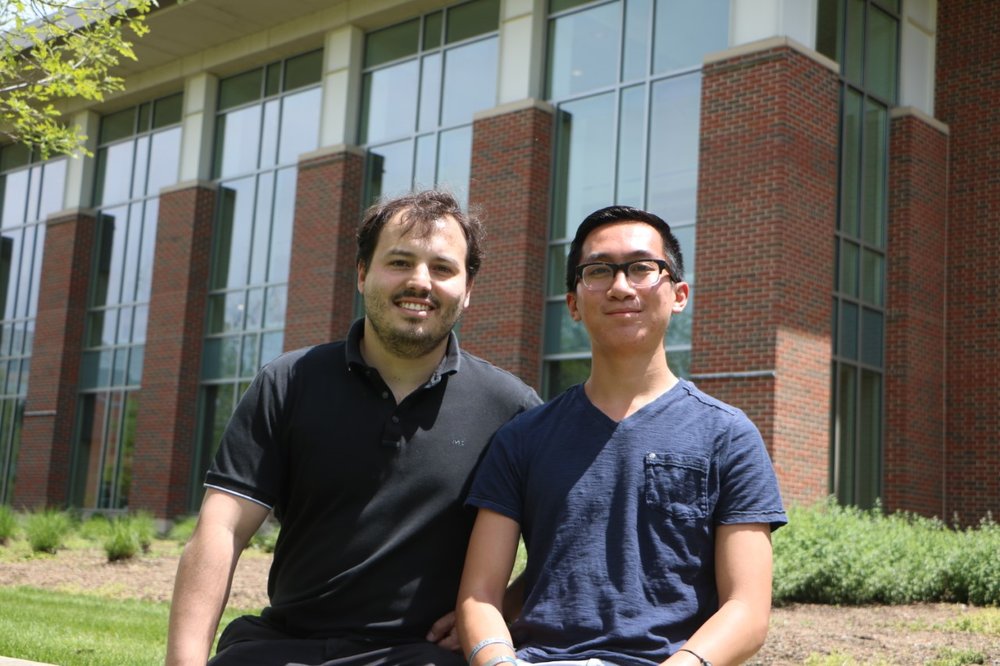
Acknowledgments
Professor Enrique Treviño
Lake Forest College
Richter Scholar Program

Slide 21
Referenced Works
Gale, D., & Shapley, L. (1962). College Admissions and the Stability of Marriage. The American Mathematical Monthly, 69(1), 9-15. doi:10.2307/2312726​
Irving, R. W. (2015). Optimal Stable Marriage. Retrieved May 30, 2019, from https://link.springer.com/content/pdf/10.1007/978-3-642-27848-8_271-2.pdf ​
Mathematics | Matching (graph theory). (2018, February 09). Retrieved from https://www.geeksforgeeks.org/mathematics-matching-graph-theory/​
Numberphile. (2014, September 04). Stable Marriage Problem - Numberphile. Retrieved from https://www.youtube.com/watch?v=Qcv1IqHWAzg​
University of California,University of California. (2016, February 10). How a matchmaking algorithm saved lives. Retrieved from https://medium.com/@UofCalifornia/how-a-matchmaking-algorithm-saved-lives-2a65ac448698​

